Slide 1
Module 5
E- Waste Management

Slide 2
Contents
Introduction
sources of e-waste
Composition, Characteristics, and Need of e-waste management
Toxic materials used in manufacturing electronic and electrical products
Health hazards due to exposure to e-waste
Recycling and Recovery
Extraction of Gold from E-waste
Role of stake holders in environmental management of e-waste

Slide 3
Introduction
Waste Management
Waste can take any form that is solid, liquid [or] gas.
Waste is any substance which is discarded after primary use.
Ex:- Municipal solid waste, Hazardous waste, waste water, etc…
Waste management is defined as “all the activities and actions required to manage waste from its collections to its final disposal”.

Slide 4
Types of Waste Management
Solid Waste Management ( SWM)
E-waste Management (Electronic waste) (EWM)
Biomedical waste Management (BWM)

Slide 5
It is defined as electronic products that have become unwanted, no-working and have essentially reached the end of their useful life.
SOURCES
Electronic devices such as TV’s, computer monitors, laptops and display devices.
Telecommunication devices such as cellphones, calculators, audio and video devices, printers,scaneers, fax machines etc…..

Slide 6
SOURCES
Electronic components such as sensors, alarms, sirens, security devices automobile electronic devices.
Kitchen equipment's (coffee makers, microwave ovens)
Laboratory equipment's (hot plates, microscopes, microwave ovens)

Slide 7
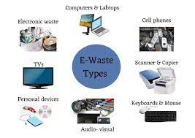

Slide 8
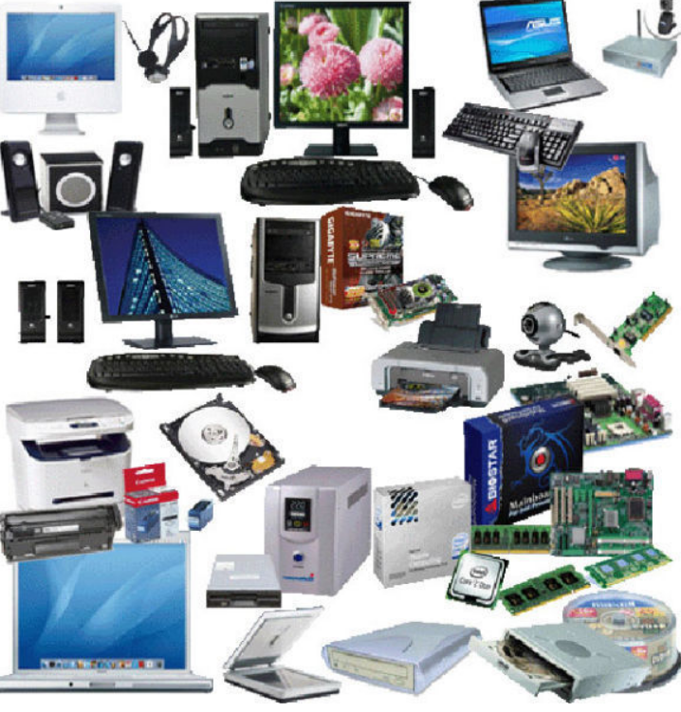

Slide 9
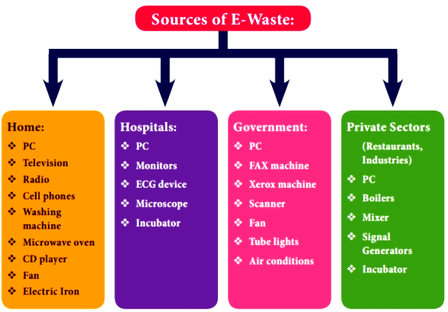

Slide 10
Composition of E- Waste
Valuable metals like Gold, Platinum, Silver and Palladium.
Useful metals like Copper, Aluminum, Iron, etc.,
Hazardous substances like radioactive isotopes and Mercury.
Plastic like Polystyrene, Polycarbonate, Polyphenelyne oxide, etc.,

Slide 11
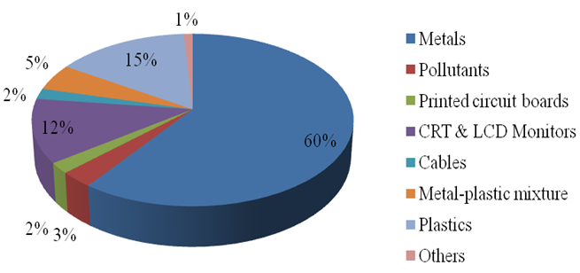

Slide 12
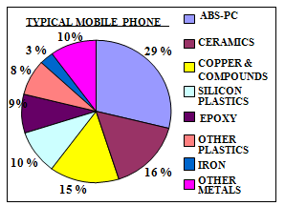

Slide 13
Characteristics of E-Waste
E-Waste is generally characterized by analyzing the components and composition of waste.
Hazardous components in e-waste
E-waste consists of a large number of components of various sizes and shapes, some of which contain hazardous components that need to be removed for separate treatment.
Material composition of e-waste
E-waste contains a mixture of various metals, particularly copper, aluminum and steel etc...

Slide 14
Need of E- Waste Management:
E- waste is a complex mixture of metals, organics and ceramics.
Disposing of e – waste in landfills can cause serious environmental issues.
E-waste can be toxic, is not biodegradable and accumulates in the environment, in the soil, air, water and living things.
Causes air pollution, Soil pollution and water poluution.

Slide 15
Toxic materials used in manufacturing Electronic and Electrical products
Circuit boards contains : Lead, Cadmium
CRT Monitors Contains: Lead, Barium
Flat Screen monitors, Switches contains: Mercury
Rechargeable Batteries contains: Cadmium, Lead, Sodium, Lithium, Nickel etc.,
Presence of heavy metals like Cd, Cr, Cu, Ni, Sn, Ag and AU.

Slide 16
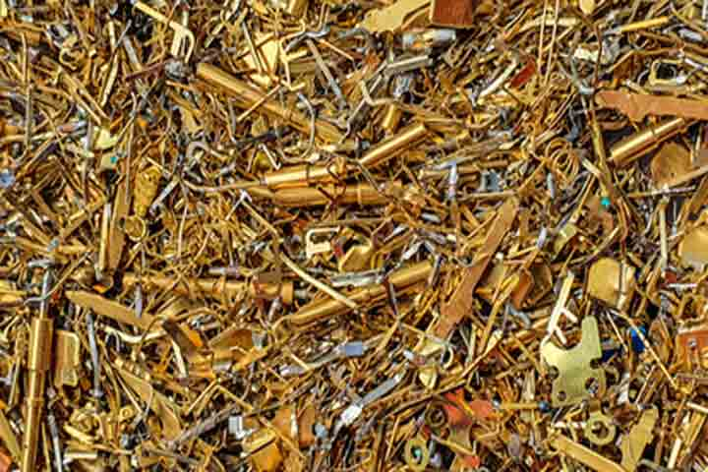
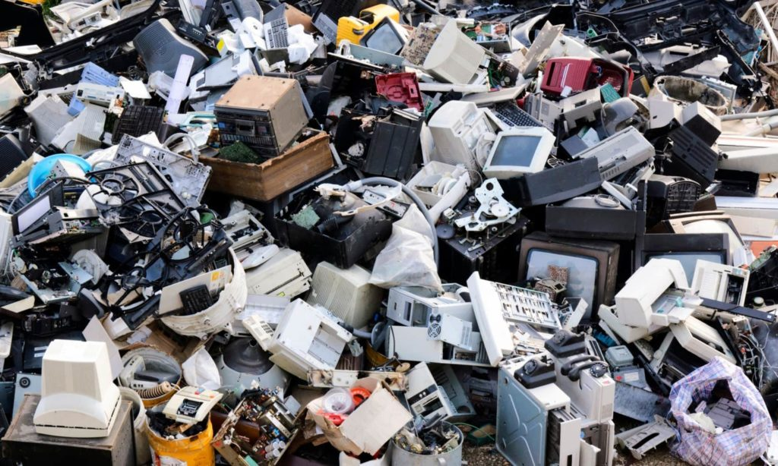
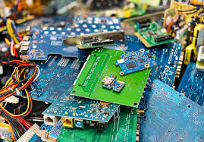
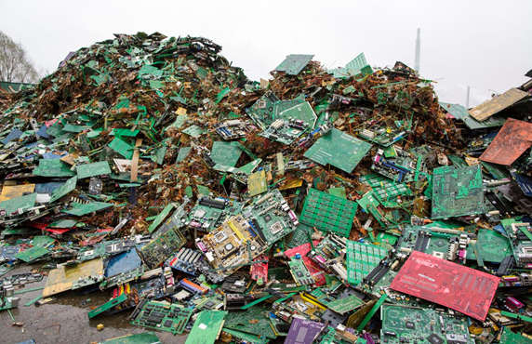

Slide 17
Health Hazards due to exposure to e-waste
Lead damages Central nervous system.
Cadmium damages Kidneys.
Mercury damages Central nervous system and Kidneys.
Carbon black (in Printer Cartridge) Causes Carcinogen
PVC wire insulation causes Carcinogen.
Dioxins, Furans affects gastro intestinal irritation, DNA damage and adverse birth effects.

Slide 18
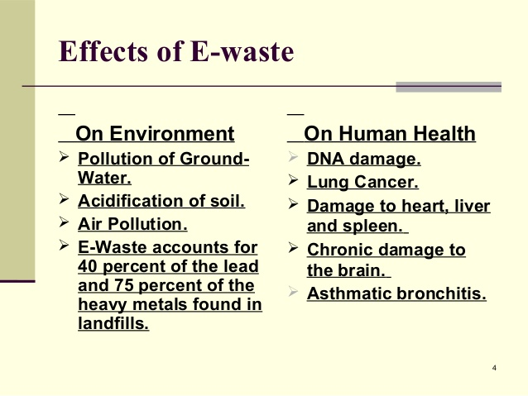

Slide 19
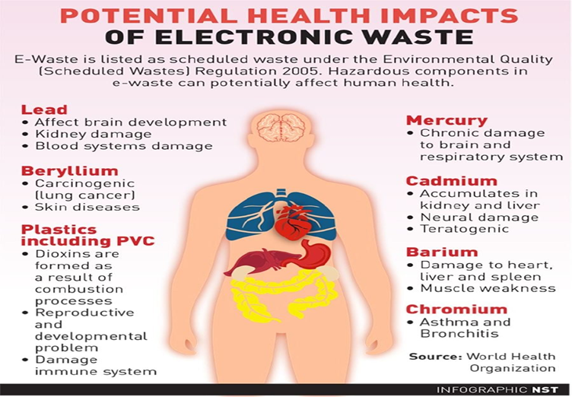

Slide 20
Recycling and Recovery of E-Waste
The following are the different approaches to recycling and recovery of e-waste
Hydrometallurgical extraction
Pyrometallurgical methods
Direct recycling

Slide 21
Hydrometallurgical Process
This method was used to extract valuable metals like Copper, Gold and Silver from e-waste.
It involves the following steps for recovery of metals from e-waste.
Pretreatment Stage
Chemical Treatment Stage
Metal recovery Stage

Slide 22
Pretreatment Stage:
It involves the physical separation of metal components from e-waste.
It involves the dismantling the e-waste into its component parts, such as Circuit Boards, Plastics and Metal Parts.
The different parts are then sorted and separated based on their composition.
The metal parts are subjected for grinding to reduce the size and make it easier to extract the metals.

Slide 23
2. Chemical Treatment Stage:
In this stage, the metals are made to leach into solutions using different leaching reagents, like Cyanide solution, Acid solution, Base solution, Thiosulphate solution, Halide solution etc.,
In the leaching solution metals are dissolved.
Then the solution was separated form solid waste.

Slide 24
3. Metal Recovery Stage:
In this stage pure metal is recovered from leached metal solution.
The methods like, Solvent extraction, Ion-exchange, Adsorption, Precipitation, Electrodeposition are used to recover the metals.
The recovered metal later used in the production of new electronic devices.

Slide 25
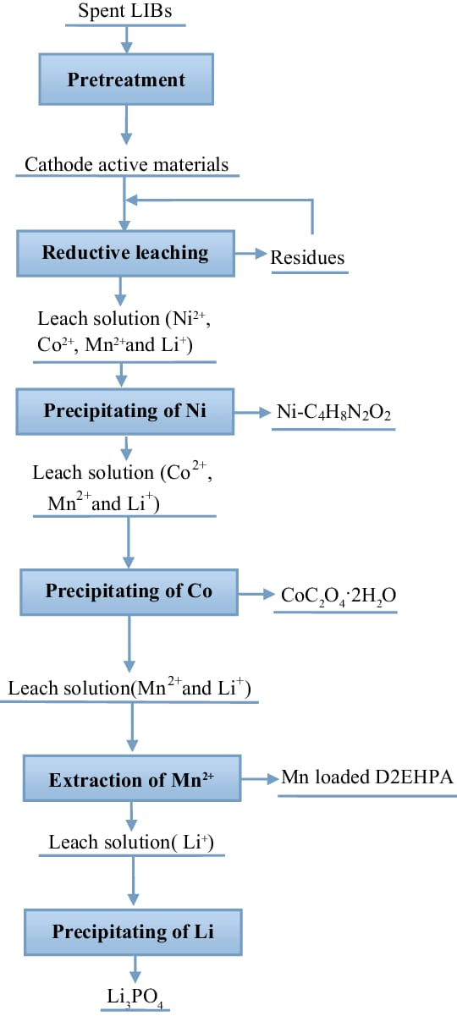

Slide 26
Pyrometallurgical Process
This method was used to extract Non-Ferrous metals like Aluminum, Copper, and Lead from e-waste.
Heating and Smelting operations are used in this process to recover the metals.
It involves the following steps for recovery of metals from e-waste.
Pretreatment Stage
Metal recovery Stage

Slide 27
Pretreatment Stage:
It involves the physical separation of metal components from e-waste.
It involves the dismantling the e-waste into its component parts, such as Circuit Boards, Plastics and Metal Parts.
The different parts are then sorted and separated based on their composition.
The metal parts are subjected for grinding to reduce the size and make it easier to extract the metals.

Slide 28
2. Metal Recovery Stage:
In this steps by using methods like Roasting, Smelting, Combustion, Incineration, Pyrolysis the useful metals are recovered from e-waste.
Roasting:- In this step, e-waste is heated below its melting Point in the presence of oxygen for oxidation.
Smelting:- In this step e-waste is reduced to metals by heating with carbon at high temperature.
It gives mixture of metals slurry.

Slide 29
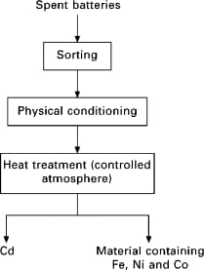
The impurities present in the metal slurry was removed by a thermal process.
Then metals was recovered from slurry using Hydrometallurgical technique.

Slide 30
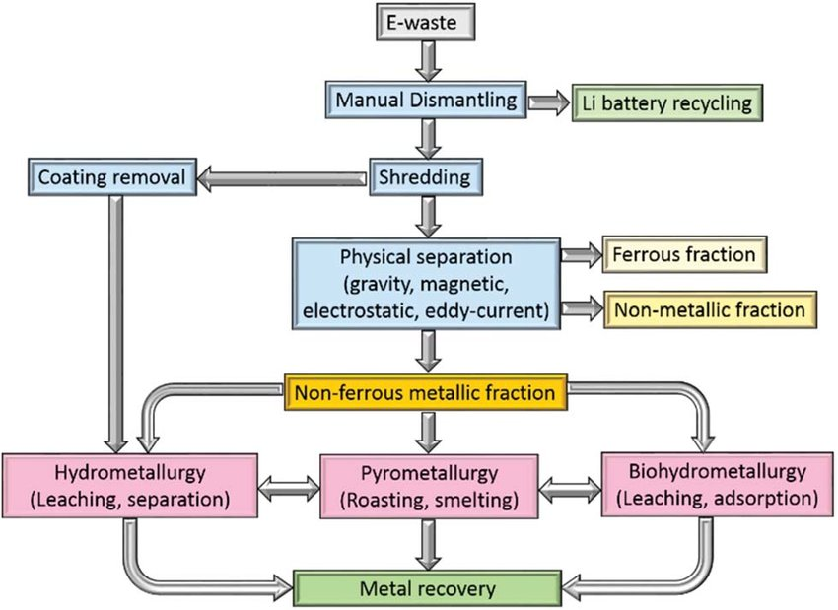

Slide 31
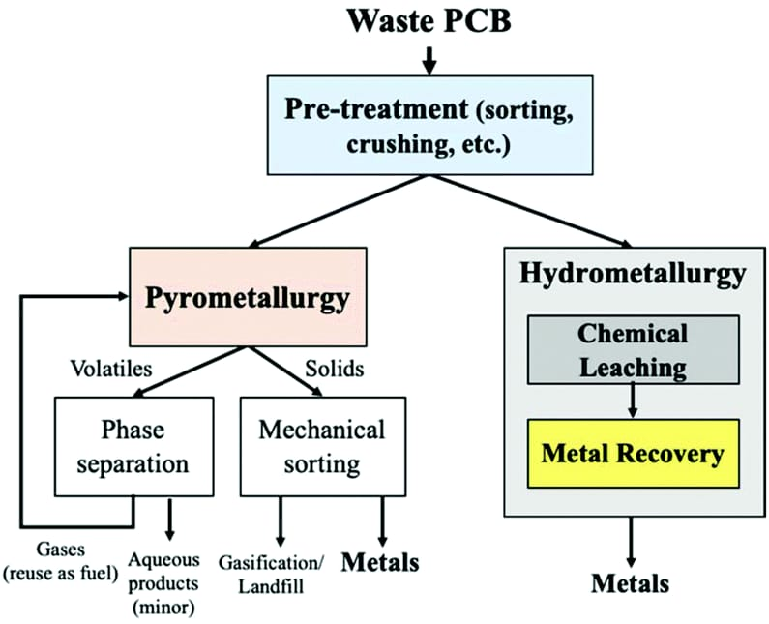

Slide 32
Extraction of Gold from E-waste
It involves the following steps,
Pretreatment Stage
Chemical Treatment Stage
Metal Recovery
1. Pretreatment Stage:-
It involves the physical separation of metal components from the e-waste.
Techniques used are gravity separation, Electrostatic separation, magnetic separation etc.,

Slide 33
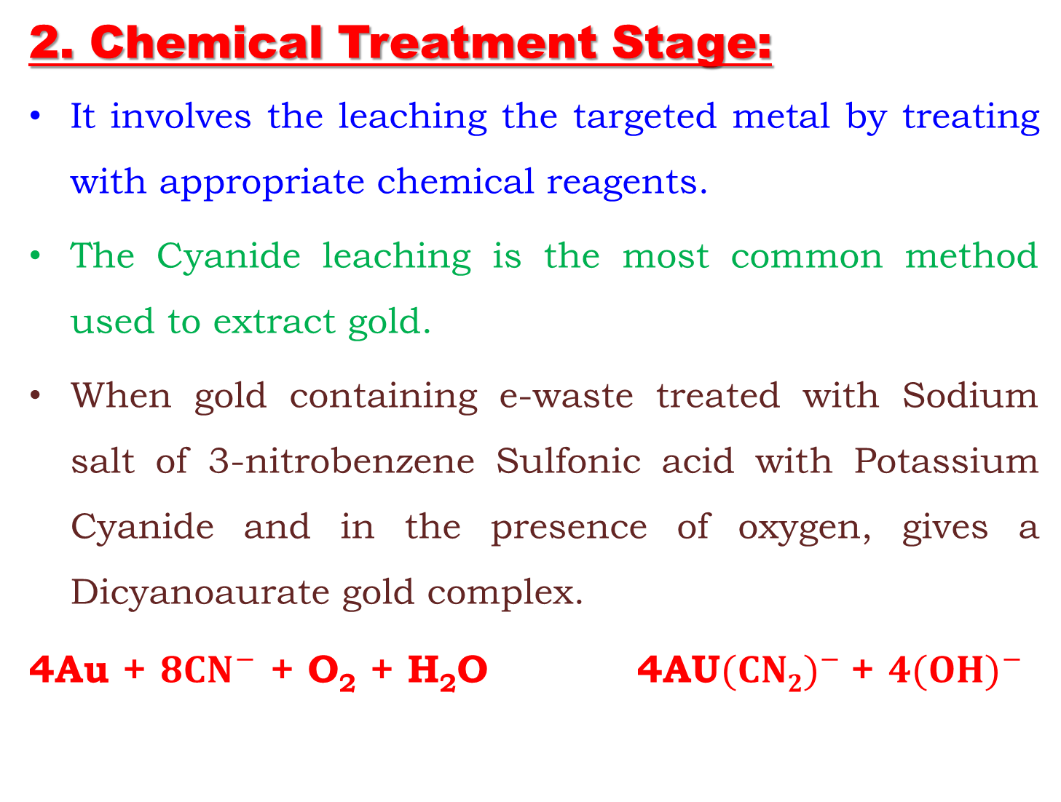
2. Chemical Treatment Stage:
It involves the leaching the targeted metal by treating with appropriate chemical reagents.
The Cyanide leaching is the most common method used to extract gold.
When gold containing e-waste treated with Sodium salt of 3-nitrobenzene Sulfonic acid with Potassium Cyanide and in the presence of oxygen, gives a Dicyanoaurate gold complex.
4Au + ${8CN}^{−}$ + O₂ + H₂O 4AU${(CN2)}^{−}$ + ${4(OH)}^{−}$
Dicyanoaurate
Gold
Complex

Slide 34
3. Metal Recovery Stage:
In this stage Gold metal can be recovered from the obtained complex using methods like Electrodeposition, Solvent – Extraction, Ion – Exchange, Precipitation, etc.,
Ex:- Electrodeposition:-
In this method pure gold metal taken as cathode and inert anode are dipped in obtained leached complex solution. When current is applied gold is electrodeposited on cathode.

Slide 35
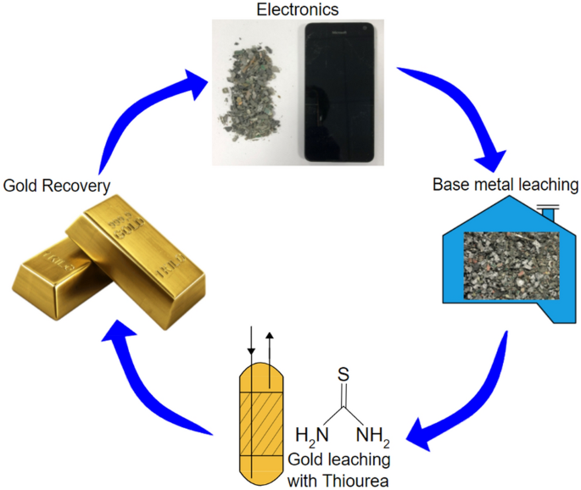

Slide 36
Extraction of Gold from E-waste
Advantages
High yield expected.
Faster extraction of gold is possible.
Disadvantages
Chemicals are used.
Acid residues are not disposed of properly, which harms the environment.

Slide 37
Direct Recycling
It is a process that involves breaking down electronic devices into their individual components and then recycling those components without the need for further processing.
It involves the following steps,
Collection and Transportation.
Disassemble.
Sorting.
Recycling.

Slide 38
1. Collection and Transportation:
e-waste is collected and transported to a recycling facility.
2. Disassembly:
Electronic devices are disassembled by hand or by using specialized equipment. This process separates the various components of the devices such as Plastics, Circuit Boards, and Metals.

Slide 39
3. Sorting:
The separated components are then sorted by material type.
Ex: Plastics are separated from metals, different types of metals are separated from each other.
4. Recycling:
The separated materials are then recycled.
Ex:- Plastics mat be melted down and molded into new Products.
Metals may be melted down and recast into new Products.

Slide 40
Role of stake holders in environmental management of e-waste
Producers
Consumers
Recyclers
Statutory Bodies

Slide 41
Producers
The accountability to collect green tax.
Charging an additional amount on consumer during sell of e- products and returning it with interest at the time of exchange of e-products.
Forming the group of manufactures who monitor and encourage the recycling of e-waste.
Baring the transportation cost and collection fees to easy the collection process.
Purchase the recycled material at fixed value and using of recycled e-waste during manufacturing.
Giving discount to consumer on the basis of e-waste generated from gadget.

Slide 42
Consumers
The accountability to pay green taxes.
Develop self- awareness on e- waste management and involve in awareness programs.
Returning back of e- waste to collection units.

Slide 43
Recyclers
The accountability of recycling units is dismantling.
Establish the collection units and the group of people who can ensure return back of e- products by consumer in exchange offer.
Collect the e- waste from the collection units, dealer or retailer.
Providing incentives when proper collection of e- waste assured by collection units.
Recycling the materials from e-waste.

Slide 44
Statutory Bodies
To collect the green tax form consumer through producer.
Apply some extra charge on the producers (manufacturing units) in the form of penalty when no proper recycling of e-waste.
Provide the incentives in the form of subsidy to recyclers and collectors when recycling of e- waste is monitored properly.
To conduct programs of awareness in the society about importance of e- waste recycling in reduction of hazardous substances.

Slide 45
Expected Questions
Mention the sources of e-waste and explain the need for e-waste management.
Explain the Characteristics of e-waste and Mention the Toxic materials used in the manufacturing of electrical materials.
Explain the ill effects of toxic materials used in manufacturing electrical and electronic products
Explain the pyrometallurgical and Hydrometallurgical process for recycling of e-waste.
Explain the Direct recycling of e-waste.
Explain the extraction of gold from e-waste
Write a brief note on role of stakeholders for example; producers, consumers, recyclers, and statutory bodies (Government Regulatory bodies )

Slide 46

GO GREEN AND THANK YOU

